Slide 1
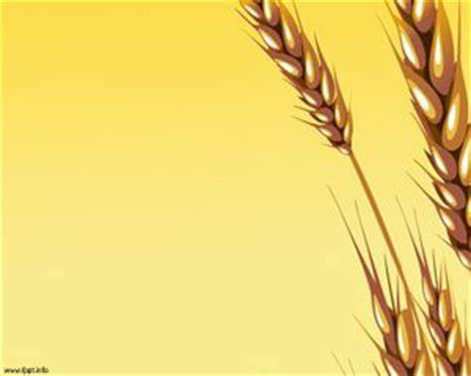

SCHOOL OF COMPUTING
DEPARTMENT OF COMPUTER SCIENCE & ENGINEERING
HACKATHON
WINTER SEMESTER(20-21)
“GLOBAL WHEAT DETECTION”
PRESENTED BY
NALLAREDDY JISHNU (8613,17UECS0494)
KAMMA RAHUL(8877,17UECS0)

Slide 2

Can you help identify wheat heads using Image analysis?

Slide 3

PROBLEM STATEMENT
Detection of wheat heads is an important task allowing to estimate pertinent traits including head population density and head characteristics such as sanitary state, size, maturity stage and the presence of awns.
The Problem Statement further includes variability in observational conditions, genotypic differences, development stages, head orientation represents a challenge in computer vision.

Slide 4
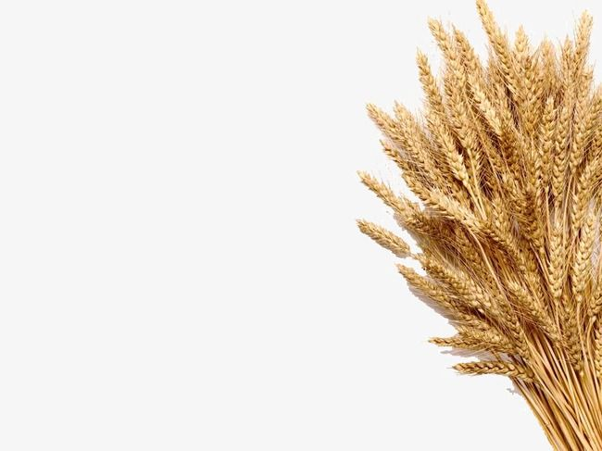
ABSTRACT
Field phenotyping by remote sensing has received increased interest in recent years with the possibility of achieving high-throughput analysis of crop fields. Along with the various technological developments, the application of machine learning methods for image analysis has enhanced the potential for quantitative assessment of a multitude of crop traits. For wheat breeding purposes, assessing the production of wheat spikes, as the grain-bearing organ, is a useful proxy measure of grain production. Thus, being able to detect and characterize spikes from images of wheat fields is an essential component in a wheat breeding pipeline for the selection of high yielding varieties.

Slide 5

DESCRIPTION
Wheat is a staple across the globe, which is why this competition must account for different growing conditions.
Indeed, your morning toast or cereal may rely upon this common grain. Its popularity as a food and crop makes wheat widely studied.
To get large and accurate data about wheat fields worldwide, plant scientists use image detection of "wheat heads"—spikes atop the plant containing grain.
These images are used to estimate the density and size of wheat heads in different varieties.
Farmers can use the data to assess health and maturity when making management decisions in their fields.

Slide 6
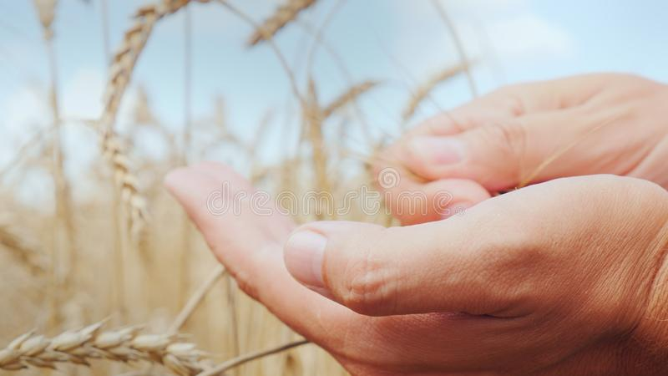
ABOUT THE DATASET
The Global Wheat Head Dataset is led by nine research institutes from seven countries.
We will detect wheat heads from outdoor images of wheat plants, including wheat datasets from around the globe.
Using worldwide data, you will focus on a generalized solution to estimate the number and size of wheat heads.
To better gauge the performance for unseen genotypes, environments, and observational conditions, the training dataset covers multiple regions. You will use more than 3,000 images from Europe (France, UK, Switzerland) and North America (Canada). The test data includes about 1,000 images from Australia, Japan, and China.

Slide 7
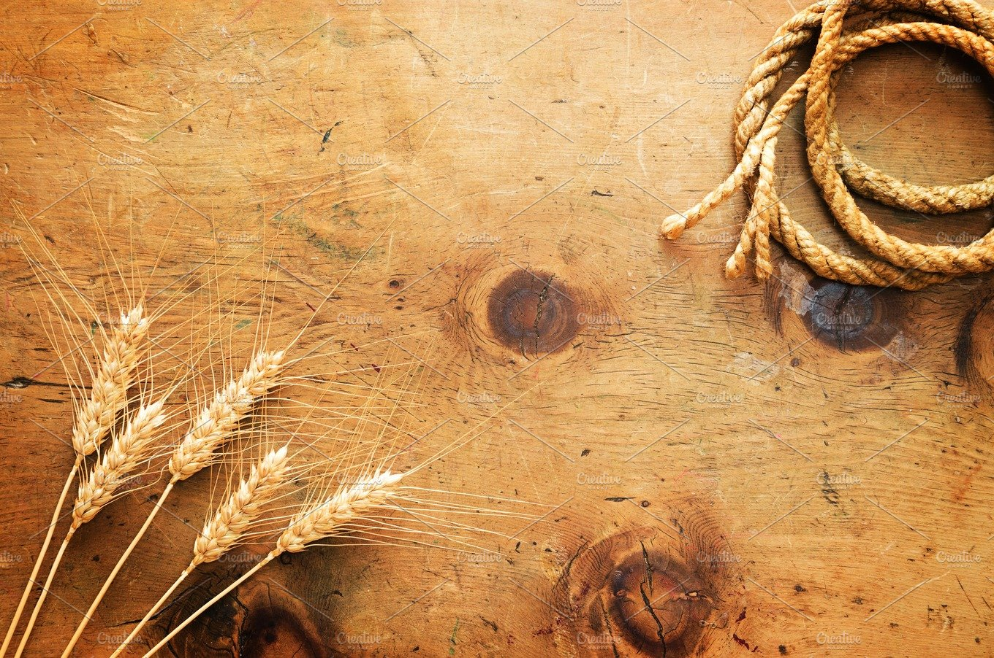
Methodology:
This project helps to know the count of wheat grains ,wheat related diseases , estimation of the quantity and the verities of wheat breed.
So we collect the data set(image) in the resolution of (5184x3186). These images should follow the constraints like
Focal length—18 mm,
Aperture—f/9.0,
ISO—automatic and
Exposure time—1/500 s.

Slide 8

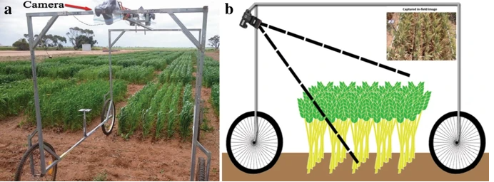
Way to collect the data set:
The ground-based vehicle for imaging in the field. a A camera, angled for oblique viewing, is placed at the top of an imaging frame mounted on a four-wheel base (the wagon). The frame also supports two stereo cameras, angled vertically, placed in the center of the top section. These have not been used in this article.
b A schematic of the wagon from a side-view. A sample image taken with the oblique-view camera is shown in the inset, top right.

Slide 9
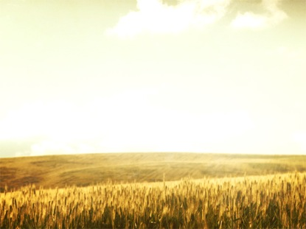
CONVERSIONS
The image should be converted into grey format by using rgb2gray() then by using threshold_yen() function in filters to find the grains in the image
If the image value is less than threshold value of the image after converting to threshold_yen() them the image is ignored.
If it is more than the threshold value then we draw a rectangular boxes around the wheat grains.

Slide 10
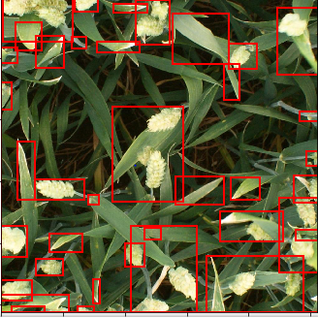
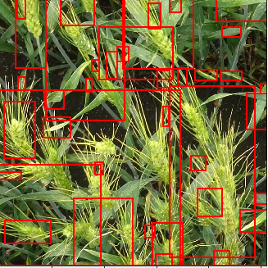
Outputs:

Slide 11
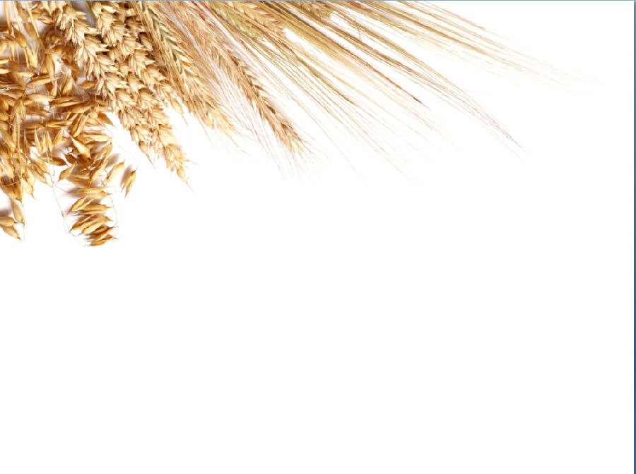
CONCLUSION
With the availability of good training datasets deep learning techniques can achieve high accuracy in detecting and counting spikes from complex wheat field images.
The proposed robust R-CNN model, which has been trained on spike images captured during different growth stages, is optimized for application to a wider variety of field scenarios.
It accurately quantifies the differences in yield produced by the 10 varieties we have studied, and their respective responses to fertilizer treatment.
We have also observed that the other R-CNN models exhibit more specialized performances. The data set and the R-CNN model, which we make publicly available, have the potential to greatly benefit plant breeders by facilitating the high throughput selection of high yielding varieties.

Slide 12

THANK YOU!!

